Slide 1
PROCESSES IN LINUX

Slide 2
Unit content
Processes in Linux
Definition of a Process
Process States
Process Concepts
Process Creation in Linux

Slide 3
Objective
This unit describes what a process is and how the Linux kernel creates, manages and deletes the processes in the system.

Slide 4
Introduction
Linux is one of multi-user and multiprocessing operating systems,
Linux has its solution to the system resource management.
Linux kernel handles almost all the basic issues related to process management, memory management, file system, and I/O system, and provide well-defined system programs that have the clear-cut assignment of responsibility in order to allow user programs to call them with system calls

Slide 5
Definition of a Process
A process is an instance of a computer program, consisting of one or more threads, that is being sequentially executed by a computer system that has the ability to run several computer programs concurrently.
A thread of execution is often regarded as the smallest unit of processing that a scheduler works on.

Slide 6
Linux Processes
In a very basic form, Linux process can be visualized as running instance of a program.
Processes are fundamental to Linux as each and every work done by the OS is done in terms of and by the processes.
This is because any work that is intended to be done requires system resources ( that are provided by kernel)

Slide 7
Process
A program is a set of machine code instructions and data stored in an executable image on disk and is, as such, a passive entity;
A process can be thought of as a computer program in action.
Several processes may be associated with the same program; for example, opening up several instances of the same program often means more than one process is being executed.

Slide 8
Threads
A thread of execution is the smallest unit of processing that can be scheduled by an operating system.
The implementation of threads and processes differs from one operating system to another, but in most cases, a thread is contained inside a process
Multiple threads can exist within the same process and share resources such as memory, while different processes do not share these resources

Slide 9
Multithreading
In computer architecture, multithreading is the ability of a central processing unit (CPU) or a single core in a multi-core processor to execute multiple processes or threads concurrently, appropriately supported by the operating system.
This approach differs from multiprocessing, as with multithreading the processes and threads have to share the resources of a single or multiple cores

Slide 10
Multithreading
On a single processor, multithreading generally occurs by time-division multiplexing (as in multitasking)
The processor switches between different threads.
This context switching generally happens frequently enough that the user perceives the threads or tasks as running at the same time.
On a multiprocessor or multi-core system, the threads or tasks will actually run at the same time, with each processor or core running a particular thread or task.

Slide 11
Time-sharing(1)
A single computer processor executes one or more instructions at the same time, one after the other.
To allow users to run several programs at once (e.g., so that processor time is not wasted waiting for input from a resource), single-processor computer can perform time-sharing.
Time-sharing allows processes to switch between being executed and waiting (to continue) to be executed.

Slide 12
Time-sharing(2)
This is done very rapidly, providing the illusion that several processes are executing 'at once'. (This is known as concurrency or multiprogramming.)
Using more than one physical processor on a computer, permits actual simultaneous execution of more than one stream of instructions from different processes, but time-sharing is still typically used to allow more than one process to run at a time.

Slide 13
Time Sharing
In time-sharing systems, the running task is required to relinquish the CPU, either voluntarily or by an external event such as a hardware interrupt.
Time sharing systems are designed to allow several programs to execute apparently simultaneously.

Slide 14
Each execution of the same set of instructions is known as an instance— a completely separate instantiation of the program.
For security and reliability reasons most modern operating systems prevent direct communication between 'independent' processes, providing strictly mediated and controlled inter-process communication functionality.

Slide 15
Process
The process also includes the program counter and all of the CPU's registers as well as the process stacks containing temporary data such as routine parameters, return addresses and saved variables.
The current executing program, or process, includes all of the current activity in the microprocessor.
Linux is a multiprocessing operating system.

Slide 16
Processes
Processes are separate tasks each with their own rights and responsibilities. If one process crashes it will not cause another process in the system to crash.
Each individual process runs in its own virtual address space and is not capable of interacting with another process except through secure, kernel managed mechanisms.
Linux is a multiprocessing operating system.

Slide 17
Processes
Processes are separate tasks each with their own rights and responsibilities.
If one process crashes it will not cause another process in the system to crash.
Each individual process runs in its own virtual address space and is not capable of interacting with another process except through secure, kernel managed mechanisms

Slide 18
Processes
During the lifetime of a process it will use many system resources.
It will use the CPUs in the system to run its instructions and the system's physical memory to hold it and its data.
It will open and use files within the file systems and may directly or indirectly use the physical devices in the system.
Linux must keep track of the process itself and of the system resources that it has so that it can manage it and the other processes in the system fairly.

Slide 19
Processes
The most precious resource in the system is the CPU, usually there is only one.
Linux is a multiprocessing operating system; its objective is to have a process running on each CPU in the system at all times, to maximize CPU utilization.
If there are more processes than CPUs (and there usually are), the rest of the processes must wait before a CPU becomes free until they can be run.

Slide 20
Processes
In a uniprocessing system, eg DOS, the CPU would simply sit idle and the waiting time would be wasted.
In a multiprocessing system many processes are kept in memory at the same time. Whenever a process has to wait the operating system takes the CPU away from that process and gives it to another, more deserving process.
It is the scheduler which chooses which is the most appropriate process to run next and Linux uses a number of scheduling strategies to ensure fairness.

Slide 21
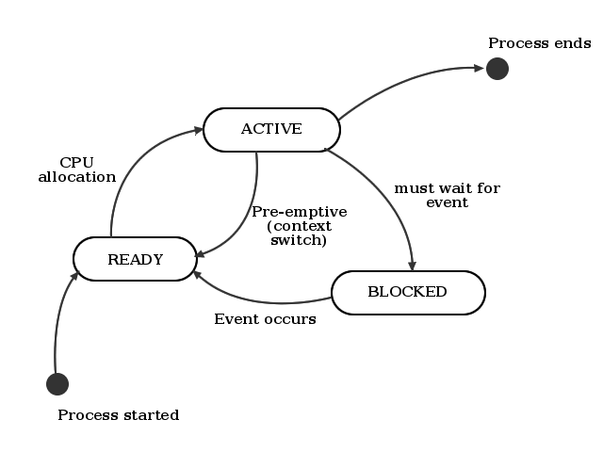
Three basic Process States.
With Linux and other variants of the Linux system there is a
slight addition to the process model.
The lifecycle of a typical Linux process is displayed below.

Slide 22
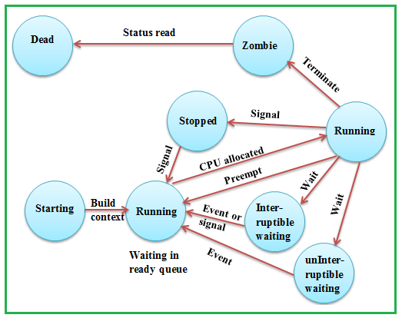

Slide 23
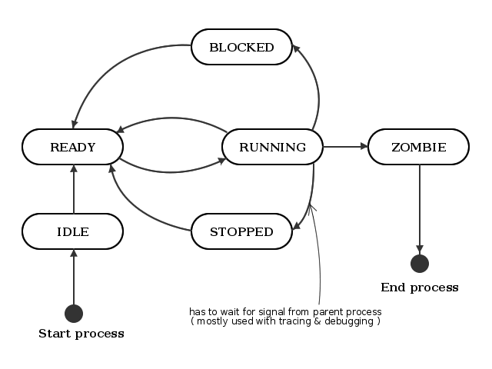
A typical Linux Process

Slide 24
Ready
At this stage the processes compute for allocation of CPU and it is usually contained in one or more queues called the ready queue.
The OS has two components for allocation the CPU namely the
Scheduler
Dispatcher.
The scheduler is responsible for strategy and planning of allocation of the CPU whilst the Dispatcher does actual allocation and context switch

Slide 25
Running
The process is either running (it is the current process in the system) or it is ready to run (it is waiting to be assigned to one of the system's CPUs).
Waiting
The process is waiting for an event or for a resource.
Linux differentiates between two types of waiting process;
Interruptible and Uninterruptible. Interruptible waiting processes can be interrupted by signals whereas uninterruptible waiting processes are waiting directly on hardware conditions and cannot be interrupted under any circumstances.

Slide 26
Blocked: A process may be blocked due to various reasons such as when a particular process has exhausted the CPU time allocated to it or it is waiting for an event to occur.
Stopped/Terminated
A process may be terminated, either from the running state by completing its execution or by explicitly being killed.
The underlying program is no longer executing but the process remains in the process table as a zombie

Slide 27
process(or defunct process is a process that has completed execution|via the exit system call| but still has an entry in the process table) until.
The process has been stopped, usually by receiving a signal. A process that is being debugged can be in a stopped state. A stopped or halted and can be restarted by some other process
Zombie
This is a halted process which, for some reason, still has a data structure entry in the main memory. It is what it sounds like, a dead process. In this state, the process will be terminated and the information will still be available in the process table.

Slide 28
Advantages of multi-threaded application
1. Responsiveness
2. Faster Execution
3. Less Resource Intensive
4. Better System Utilization
5. Simplified sharing and Communication
6.Parallelization

Slide 29
Process Concepts: The Basics of OSOS
Unix is a computer operating system originally developed in 1969 by a group of AT&T employees
Unix Design
-Portable
- multi-tasking
- multi-user in a time-sharing configuration.

Slide 30
Overview of Linux OS/Getting Acquainted with Linux
Linux is developed and maintained by a worldwide team of volunteer programmers, working together over the Internet. Linux is great for many reasons, including the fact that the folks who built it from the ground up wanted it to be
Multiuser: More than one user can be logged in to a single computer at one time.

Slide 31
Multitasking
A method by which multiple tasks, also known as processes, share common processing resources such as a CPU
The act of reassigning a CPU from one task to another one is called a context switch.
Even on computers with more than one CPU (called multiprocessor machines), multitasking allows many more tasks to be run than there are CPUs

Slide 32
Multiprogramming
Computer multiprogramming is the allocation of a computer system and its resources to more than one concurrent application, job or user
In multiprogramming systems, the running task keeps running until it performs an operation that requires waiting for an external event (e.g. reading from a tape) or until the computer's scheduler forcibly swaps the running task out of the CPU.
Multiprogramming systems are designed to maximize CPU usage.

Slide 33
Multiprogramming
The use of multiprogramming was enhanced by the arrival of virtual memory and virtual machine technology, which enabled individual programs to make use of memory and operating system resources as if other concurrently running programs were, for all practical purposes, non-existent and invisible to them.
Multiprogramming should be differentiated from multi-tasking since not all multiprogramming entails—or has the capability for-- "true" multi-tasking.
This is the case even though the use of multi-tasking generally implies the use of some multiprogramming methods

Slide 34
Multiprogramming
In this context, the root word "program" does not necessarily refer to a compiled application, rather, any set of commands submitted for execution by a user or operator
Such "program" could include a script or job control stream and any included calls to macro-instructions, system utilities or application program modules
A program generally comprises numerous tasks, a task being a relatively small group of processor instructions which together achieve a definable logical step in the completion of a job or the execution of a continuous-running application program.

Slide 35
Context Switch
A context switch is the process of storing and restoring the state (context) of a CPU such that multiple processes can share a single CPU resource.
In a context switch the contents of one process are saved and the contents of the other process are loaded into memory
A context switch can mean a register context switch, a task context switch, thread context switch, or a process context switch.

Slide 36
Interprocess Communication(IPC)
IPC is a set of techniques for the exchange of data among multiple threads in one or more processes.
Processes may be running on one or more computers connected by a network.
IPC techniques are divided into methods for message passing, synchronization, shared memory, and remote procedure calls (RPC).
The method of IPC used may vary based on the bandwidth and latency of communication between the threads, and the type of data being communicated

Slide 37
IPC
There are several reasons for providing an environment that allows process cooperation:
Information sharing
Computation speedup
Modularity
Convenience
IPC may also be referred to as Inter-thread communication and Inter-application communication

Slide 38
Pipes
A pipe is a form of redirection that is used in Linux and other Unix-like operating systems to send the output of one program to another program for further processing.
Redirection is the transferring of standard output to some other destination, such as another program, a file or a printer, instead of the display monitor(default destination).
Pipes are used to create what can be visualized as a pipeline of commands, which is a temporary direct connection between two or more simple programs

Slide 39
Self Assessment
1. What is a process?
2. Describe the primary process states.
3. Differentiate between a Blocked Process and a Waiting Process
4. What does it mean for a process to be a Zombie

